Slide 1


Hope to Skills
Lecture# 12
Irfan Malik, Dr. Sheraz Naseer

Slide 2
Agenda
Recap
Exploratory Data Analysis (EDA)
Importance of EDA
Data Cleaning
Descriptive Statistics
Mean, Median, Mode
Interquartile range
Quiz

Slide 3
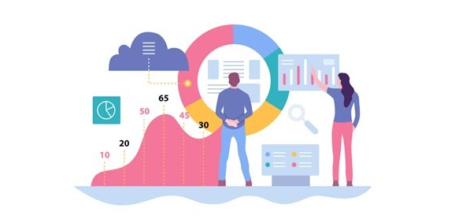
What is Exploratory Data Analysis (EDA)?
The process of exploring and summarizing the main characteristics of the data to uncover patterns, relationships, and trends.
It helps in formulating questions and making data-driven decisions.

Slide 4
Importance of EDA:
Provides an initial understanding of the dataset.
Helps in identifying data quality issues, such as missing values, outliers, and inconsistencies.
Guides the selection of appropriate statistical techniques and models.
Helps in feature engineering and variable selection.
Enables the discovery of meaningful insights and actionable conclusions.

Slide 5
Steps in EDA
Data Cleaning
Descriptive Statistics
Data Visualization
Data Distribution
Correlation Analysis
Outlier Detection
Data Transformation

Slide 6
Data Cleaning Techniques
Handling Missing Data: We use methods like filling or removing to deal with missing values.
Outlier Detection: Find and address unusual data that can affect analysis or models.
Data Standardization: Make data consistent for easier analysis and comparison.
Data Validation: Check data against rules to ensure accuracy and reliability.

Slide 7
Descriptive Statistics
Descriptive statistics is the branch of statistics that focuses on summarizing and describing the main features/Attributes/Variables of a dataset.

Slide 8
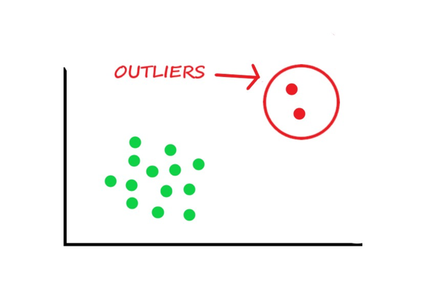
Outliers

Slide 9
Mean
The mean is the average of a set of numbers.
Calculated by summing all the numbers in the dataset and dividing by the total count.
Formula: Mean = (Sum of all numbers) / (Total count)
Example: For the dataset [5, 7, 10, 12, 15], the mean is (5 + 7 + 10 + 12 + 15) / 5 = 9.8.
Sensitive to outliers
Example: For the dataset [5, 7, 10, 12, 150], the mean is (5 + 7 + 10 + 12 + 150) / 5 = 36.8.

Slide 10
Median
The median is the middle value in a sorted dataset.
If the dataset has an odd number of values, the median is the middle number.
If the dataset has an even number of values, the median is the average of the two middle numbers.
Example 1: For the dataset [3, 5, 6, 8, 9], the median is 6.
Example 2: For the dataset [2, 4, 6, 8], the median is (4 + 6) / 2 = 5.

Slide 11
Mode
The mode is the value that appears most frequently in a dataset.
A dataset can have one mode, more than one mode (multimodal), or no mode (no value repeats).
Example 1: For the dataset [3, 4, 4, 6, 8], the mode is 4.
Example 2: For the dataset [1, 2, 3, 4, 5], there is no mode.

Slide 12
Quartiles and Interquartile Range (IQR)
Quartiles:Before understanding the IQR, we need to grasp the concept of quartiles.
Quartiles divide a dataset into four equal parts, each representing a quarter (25%) of the data.
The first quartile (Q1) is the value below which 25% of the data falls.
The first quartile (Q2) is the value below which 50% of the data falls. It's actually Median.
The third quartile (Q3) is the value below which 75% of the data falls.

Slide 13
Finding Quartiles
To find the quartiles, first, arrange the dataset in ascending order.
If the dataset has an odd number of values, the median is the second quartile (Q2).
If the dataset has an even number of values, calculate the median of the lower and upper halves to find Q2.

Slide 14
Interquartile Range (IQR):
The IQR represents the difference between the first and third quartiles(Q1 and Q3).
It indicates the spread of the middle 50% of the data.
Formula: IQR = Q3 - Q1

Slide 15
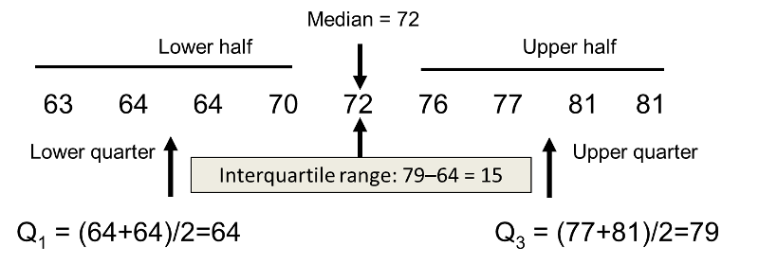
Interquartile Range (IQR):

Slide 16
Interpretation of the IQR
The IQR provides information about the spread and variability of the data.
A larger IQR indicates a greater spread and more variability in the dataset.
Conversely, a smaller IQR suggests a less spread and less variability.

Slide 17
Applications
The IQR is widely used in various fields, including economics, healthcare, and social sciences.
It helps compare and analyze data distributions, identify abnormal data points, and detect potential patterns or trends.

Slide 18
Lets move to Google collab

